Slide 1
Outcome Harvesting Workshop
Collaborated & Co-created with Oak Foundation partners
Facilitated by:
Catalyst Management Services Pvt. Ltd.

Slide 2
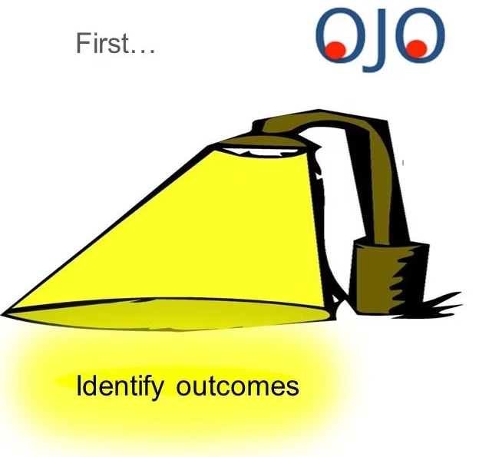
Paradigm Shift…

Slide 3


Paradigm Shift…

Slide 4
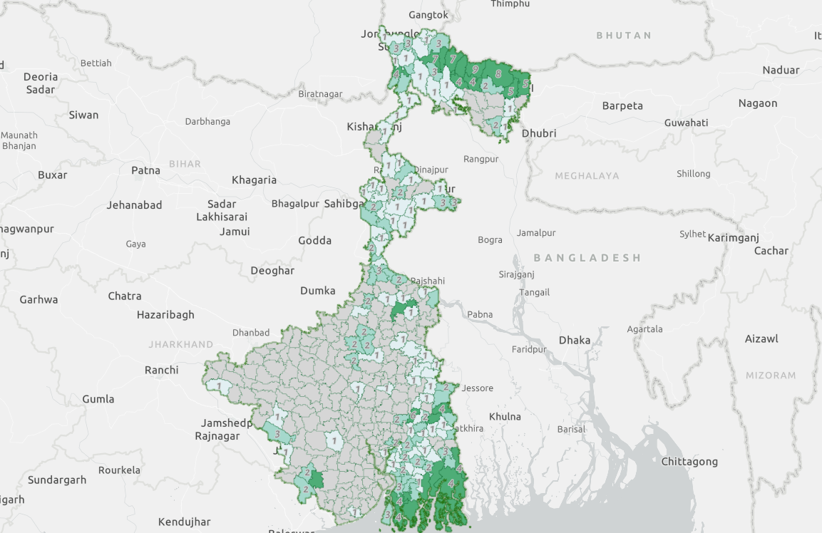
Oak’s Grantee Partners

Slide 5
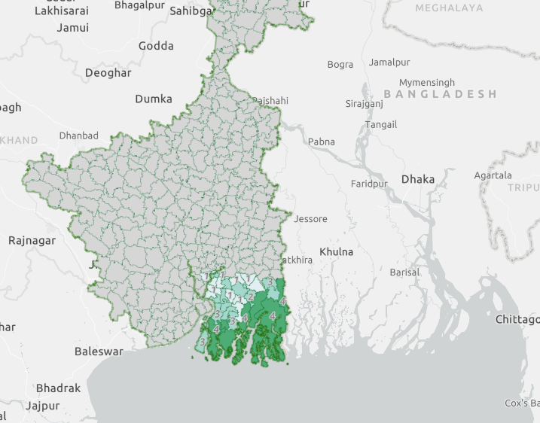
Sunderbans

Slide 6
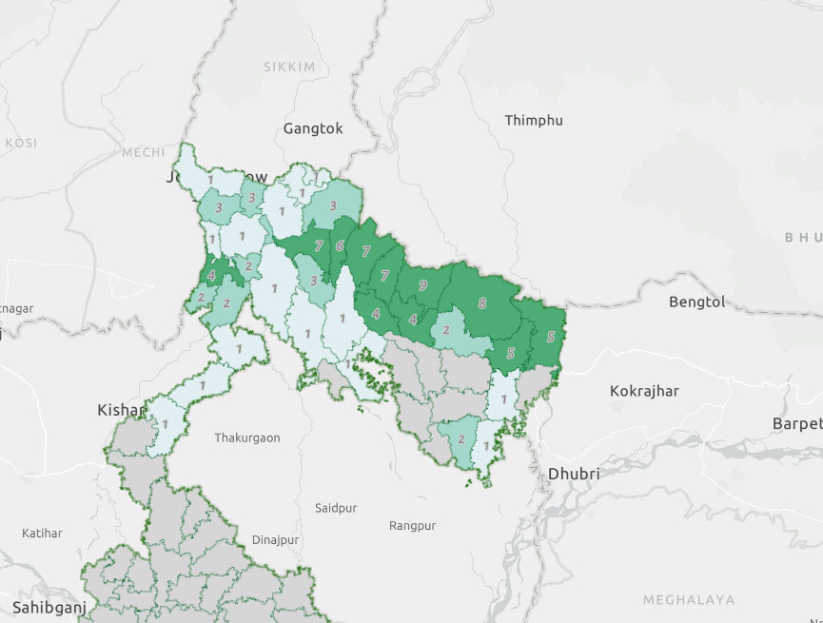
Tea Gardens

Slide 7
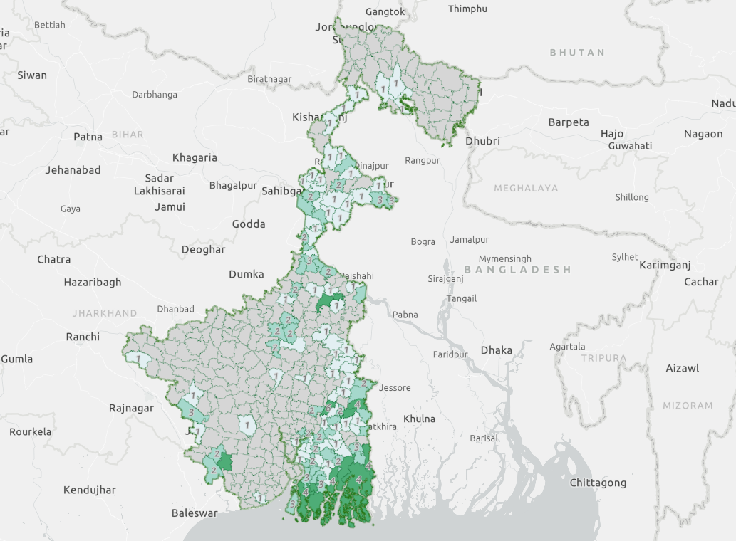
Secondary Focus Areas

Slide 8





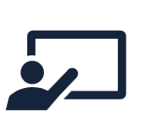
Goals & Objectives-Immersive Workshop
Align on Oak programme’s theory of change across focus areas
Agree upon the work plan and action items for the coming 6 months
Describe outcomes- maturity & verifiability, significance and contribution
Workshop Objectives
Mapping of partner’s MLE systems
CMS provides an overview of MLE systems and OH tools and process
Discuss the described outcomes - completeness, and alignment with Oak programmatic TOC

Slide 9

Expected Takeaways-Workshop & Beyond
Establish a clear outcome pathway, integrating programme level outcomes to partner-level outcomes.
Validate the programme-level Theory of Change (TOC) through iterative processes with partners, incorporating the identified modifications.
OAK FOUNDATION
Develop relationship & deepen understanding of partners
Explore outcome pathways, identification & role of boundary partners, and implementation models
Jointly ascertain the field roll out plan for outcome baseline
Initiate compilation of tools and methods for OH and orient partners on the same.
Explore & Enhance understanding of the technical and operational aspects of the Outcome Harvesting process.
Identify shared outcomes as groups and aggregate contribution & achievements to broader programme outcomes,through an iterative and experiential process
.
CMS
PARTNERS

Slide 10
Workshop Agenda
12th Feb 2024
Setting expectations
Review of Oak programme’s TOC
Overview of outcome concepts
Describing outcomes for each focus area and partner
Outcomes presentation and discussion
13th Feb 2024
Outcomes presentation and discussion
Agreeing on focus-area sub-ToCs
Overview & mapping of MLE systems
Overview of OH guides
Discussion on field plan & way ahead

Slide 11
Agenda : Day 1
Introduction of participants
Expectation setting for partners from the workshop
TOC overview : Oak programme, focus areas, boundary partners, spheres of influence, control & interest
Outcomes overview: meaning, concepts, description process
Group activity: partner groups detail their outcomes together
Partner presentation and discussion on the defined outcomes (2 of 5 groups)

Slide 12
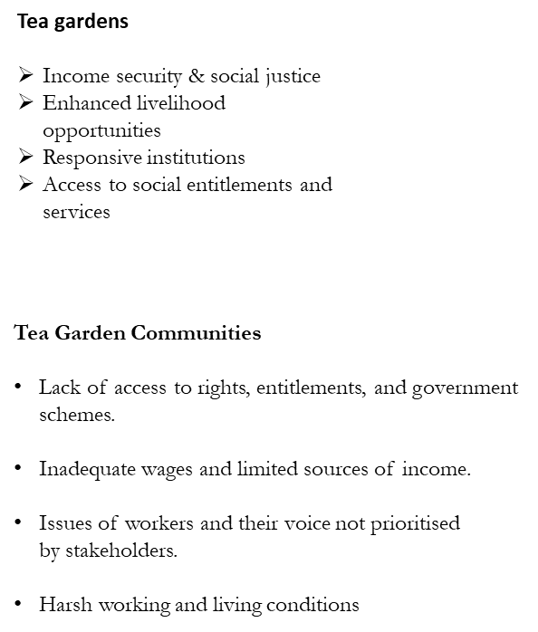
Our Understanding of the Sub program ToC- Tea Gardens

Slide 13
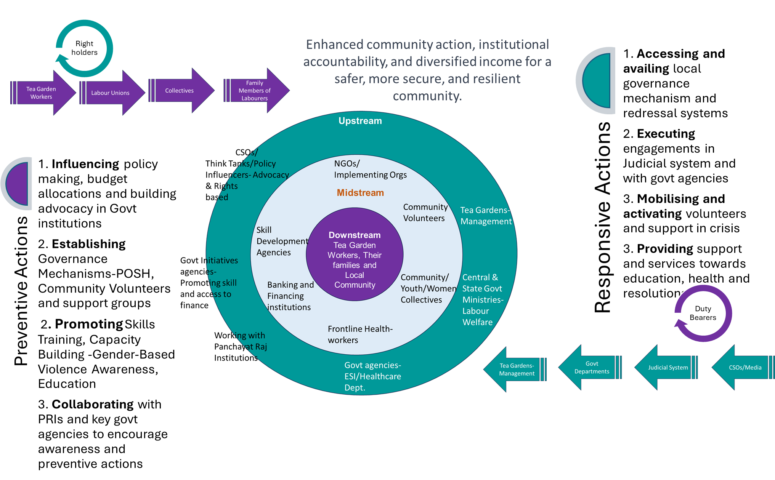
Our Understanding of the Sub program ToC- Tea Gardens

Slide 14
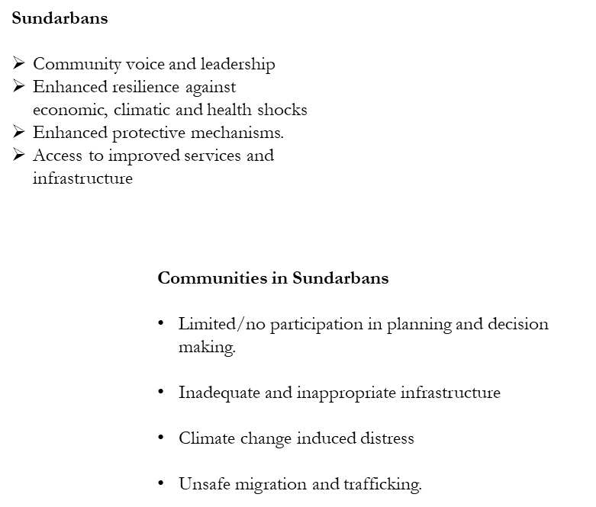
Our Understanding of the program - Sundarbans

Slide 15
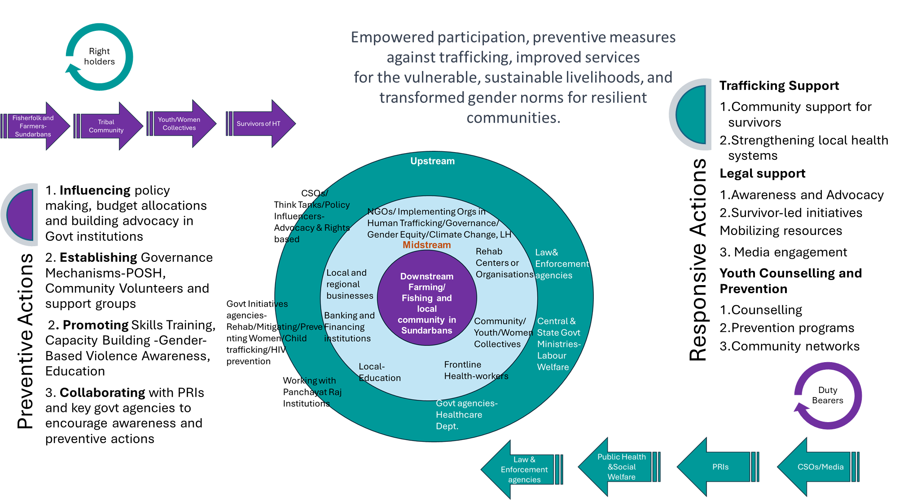
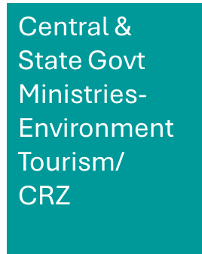
Our Understanding of the program - Sundarbans

Slide 16
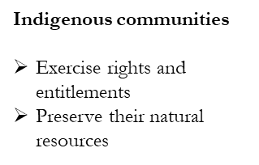
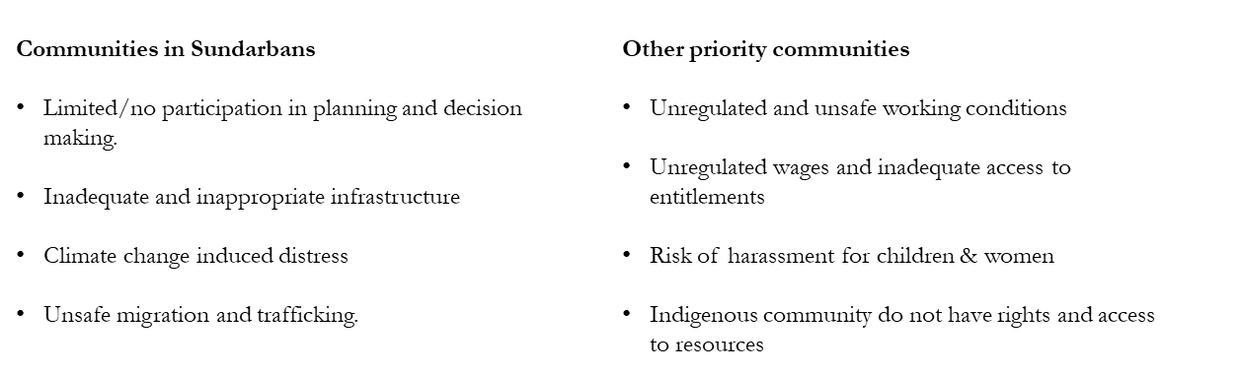
Our Understanding of the Sub program ToC- Indigenous Comm

Slide 17
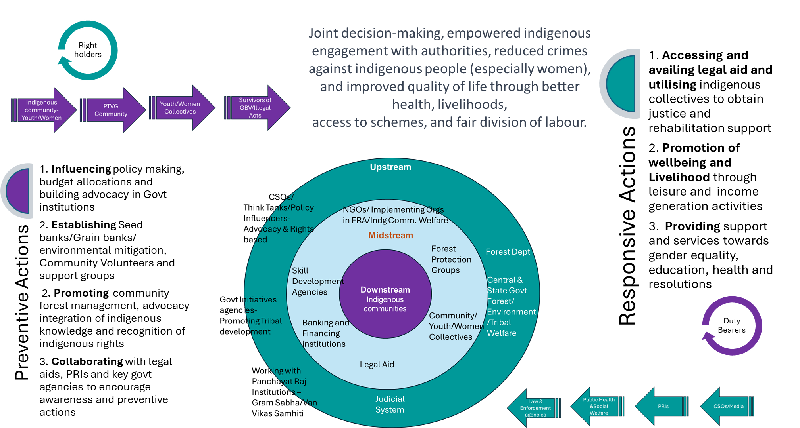
Our Understanding of the Sub program ToC- Indigenous Comm

Slide 18
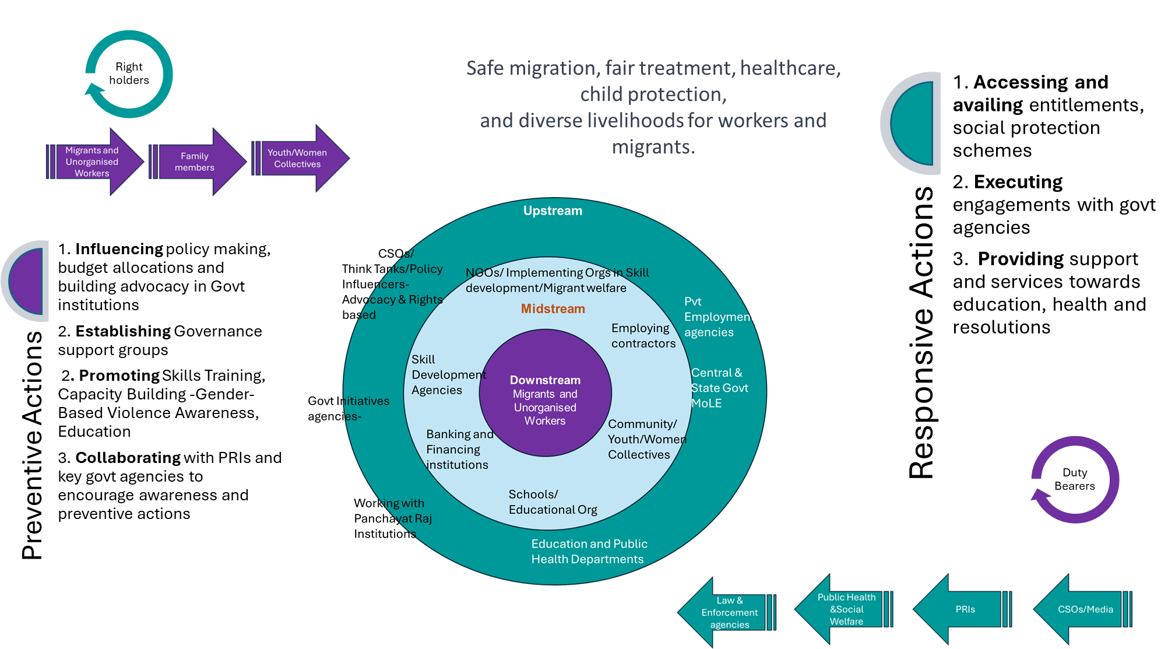
Our Understanding of the Sub program ToC- Migrants and UW

Slide 19
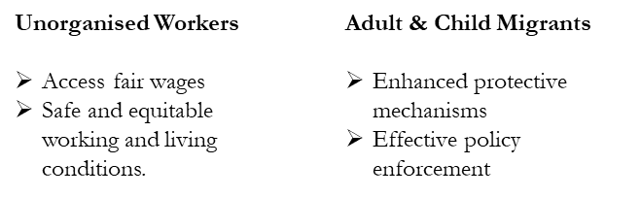
Our Understanding of the Sub program ToC- Migrant and UW

Slide 20
Groups
# | Primary Focus Area 1 - Tea Garden Communities | Primary Focus Area 2 - Communities in the Sundarbans | Primary Focus Area 2 - Communities in the Sundarbans | Secondary Focus Area 1 - Migrants and Unorganised Workers | Secondary Focus Area 2 - Indigenous Communities
1 | British Asian Trust | Baikunthapur Tarun Sangha | Aangan | DISHA | Association for India Development
2 | Kabil | Indraprastha Srijan Welfare Society | Liver Foundation | Dignity Alliance International | Centre for People's Forestry
3 | Nazdeek | Mukti | Deutsche Welthungerhilfe | Sanhita | Fund for Global Human Rights
4 | Pratham | Prajaak | IPAS | SEWA Bharat | DRCSC
5 | Swaniti Initiatives | Praxis | Water for People | IGSSS | GGF
6 | Traidcraft Exchange | Rupantaran Foundation | TDH | iProbono
7 | Video Volunteers | NCAS | Kamonohashi
8 | Environment Conservation Society
9 | ICLEI
10 | Durbar Mahila Samanwaya Samiti
11 | FPAI

Slide 21
Agenda : Day 2
Recap
Presentation from remaining work groups
Feedback / discussion on outcomes
MLE Survey
OH - Sample Journal
Action plan ahead

Slide 22

CMS Help Desk
ToC/Outcomes
Get in touch with us over email and book a slot on Tuesdays/ Thursdays!
OH Tools/ Processes
Support
Areas
Name | Designation | Email ID
Karthikeyan | Project Manager | karthik@catalysts.org
Meghna | Assistant Project Manager | meghna.singh@catalysts.org
Tarak | Field Plan Manager | tarak.wb@gmail.com
Field Planning
Queries about Upcoming Workshop

Slide 23
CMS Help Desk
Support Areas | PoC | Days
Clarifications on Outcomes/ToC | Karthikeyan /Meghna | Tuesdays, Thursdays
OH -Process & Tools | Karthikeyan /Meghna | Tuesday
Journalling Check-ins | Karthikeyan, Meghna, Tarak | Thursdays
Field Planning | Tarak and Karthikeyan | Thursdays
Data Collection | CMS Team | TBD

Slide 24
Thank you!

